Slide 1

Northwind Traders
Sales & order data for Northwind Traders, a fictitious gourmet food supplier, including information on customers, products, orders, shippers, and employees.

Slide 2
Objectives
Understanding the business needs:
Extract valuable insights from the data
Try to figure out how we can enhance the business
Find any problem that is facing the business
provide data-driven suggestions based on your understanding of the data
provide useful recommendations for helping to improve the business

Slide 3
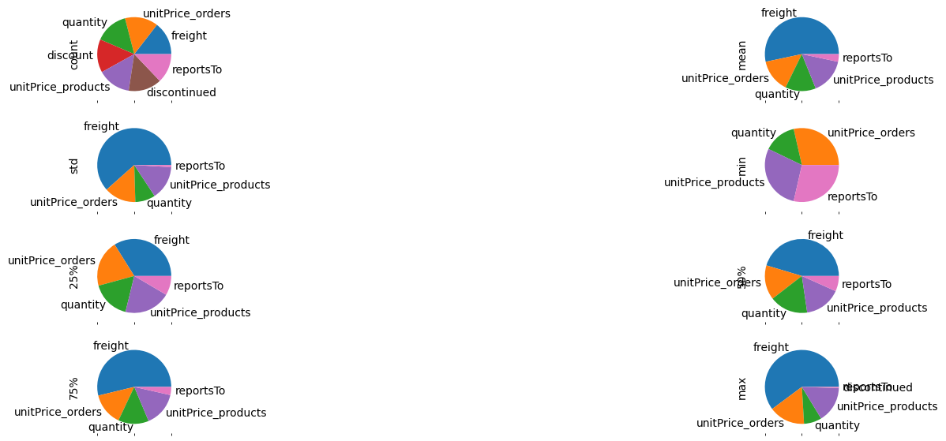
Exploratory data analysis (EDA)
Display describe of each numerical column
index | freight | unitPrice_orders | quantity | discount | unitPrice_products | days_difference_required_shipped | Sales | freight_ratio_of_sales
count | 2155.00 | 2155.00 | 2155.00 | 2155.00 | 2155.00 | 2155.00 | 2155.00 | 2155.00
mean | 96.20 | 26.218519 | 23.81 | 0.06 | 27.95 | 20.50 | 587.37 | 35.13
std | 133.01 | 29.827417 | 19.02 | 0.08 | 31.61 | 10.41 | 969.22 | 93.50
min | 0.02 | 2.000000 | 1.00 | 0.00 | 2.50 | -23.00 | 4.80 | 0.01
25% | 19.61 | 12.000000 | 10.00 | 0.00 | 12.50 | 18.00 | 147.00 | 6.16
50% | 53.80 | 18.400000 | 20.00 | 0.00 | 19.45 | 21.00 | 337.75 | 14.34
75% | 120.92 | 32.000000 | 30.00 | 0.10 | 34.00 | 25.00 | 656.00 | 33.39
max | 1007.64 | 263.500000 | 130.00 | 0.25 | 263.50 | 62.00 | 15810.00 | 3144.39

Slide 4
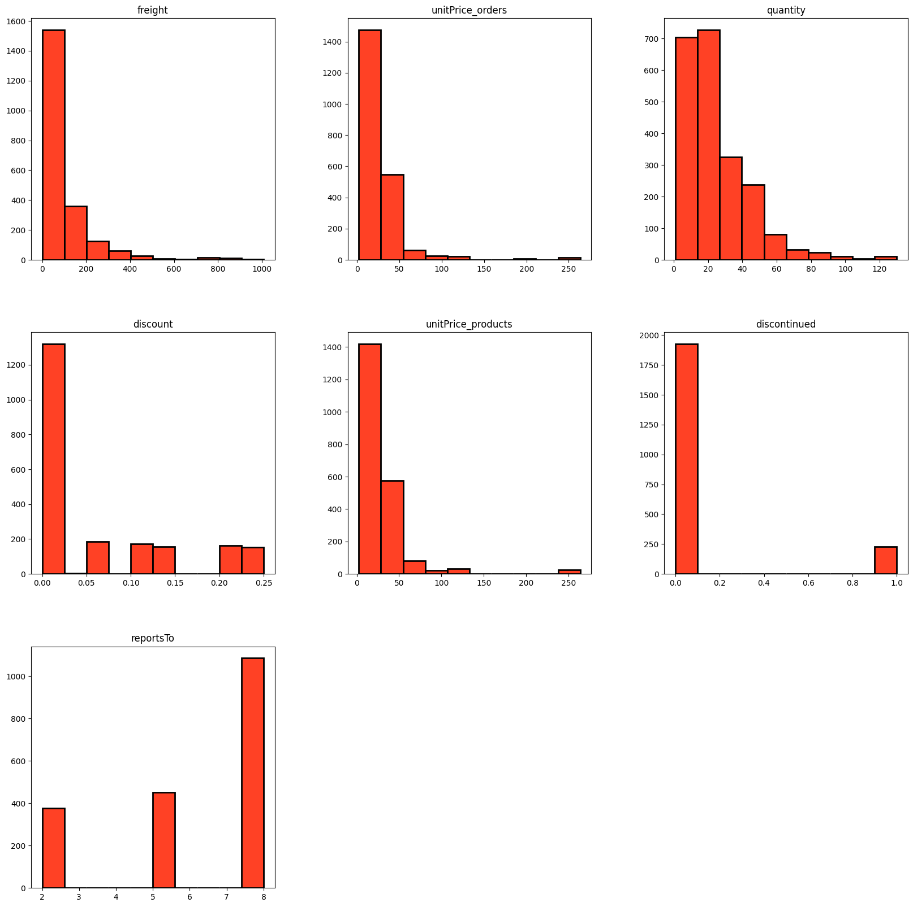
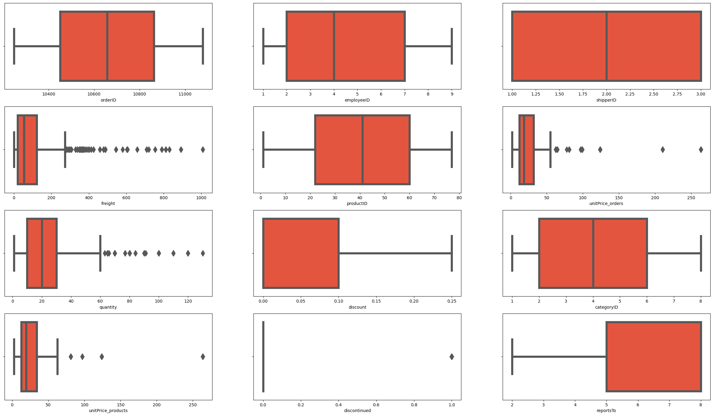
Outliers And Normality
investigate Outliers:
"freight" column has 150 outliers between 275 to 1007 are outliers so if I removed the outliers the max value would be 275 but I will leave it to study this group in-depth
"discontinued" column contains just 1 and 0 there aren't outliers that prove why zscore hasn't seen any outliers in this column
"unitPrice_orders" column has 98 outliers between 62 to 263 are outliers so if I removed the outliers the max value would be 62 maybe there are some units that have a higher price than others so I will leave it to figure out later
"quantity" column has 87 outliers between 63 to 130 are outliers so if I removed the outliers the max value would be 63

Slide 5
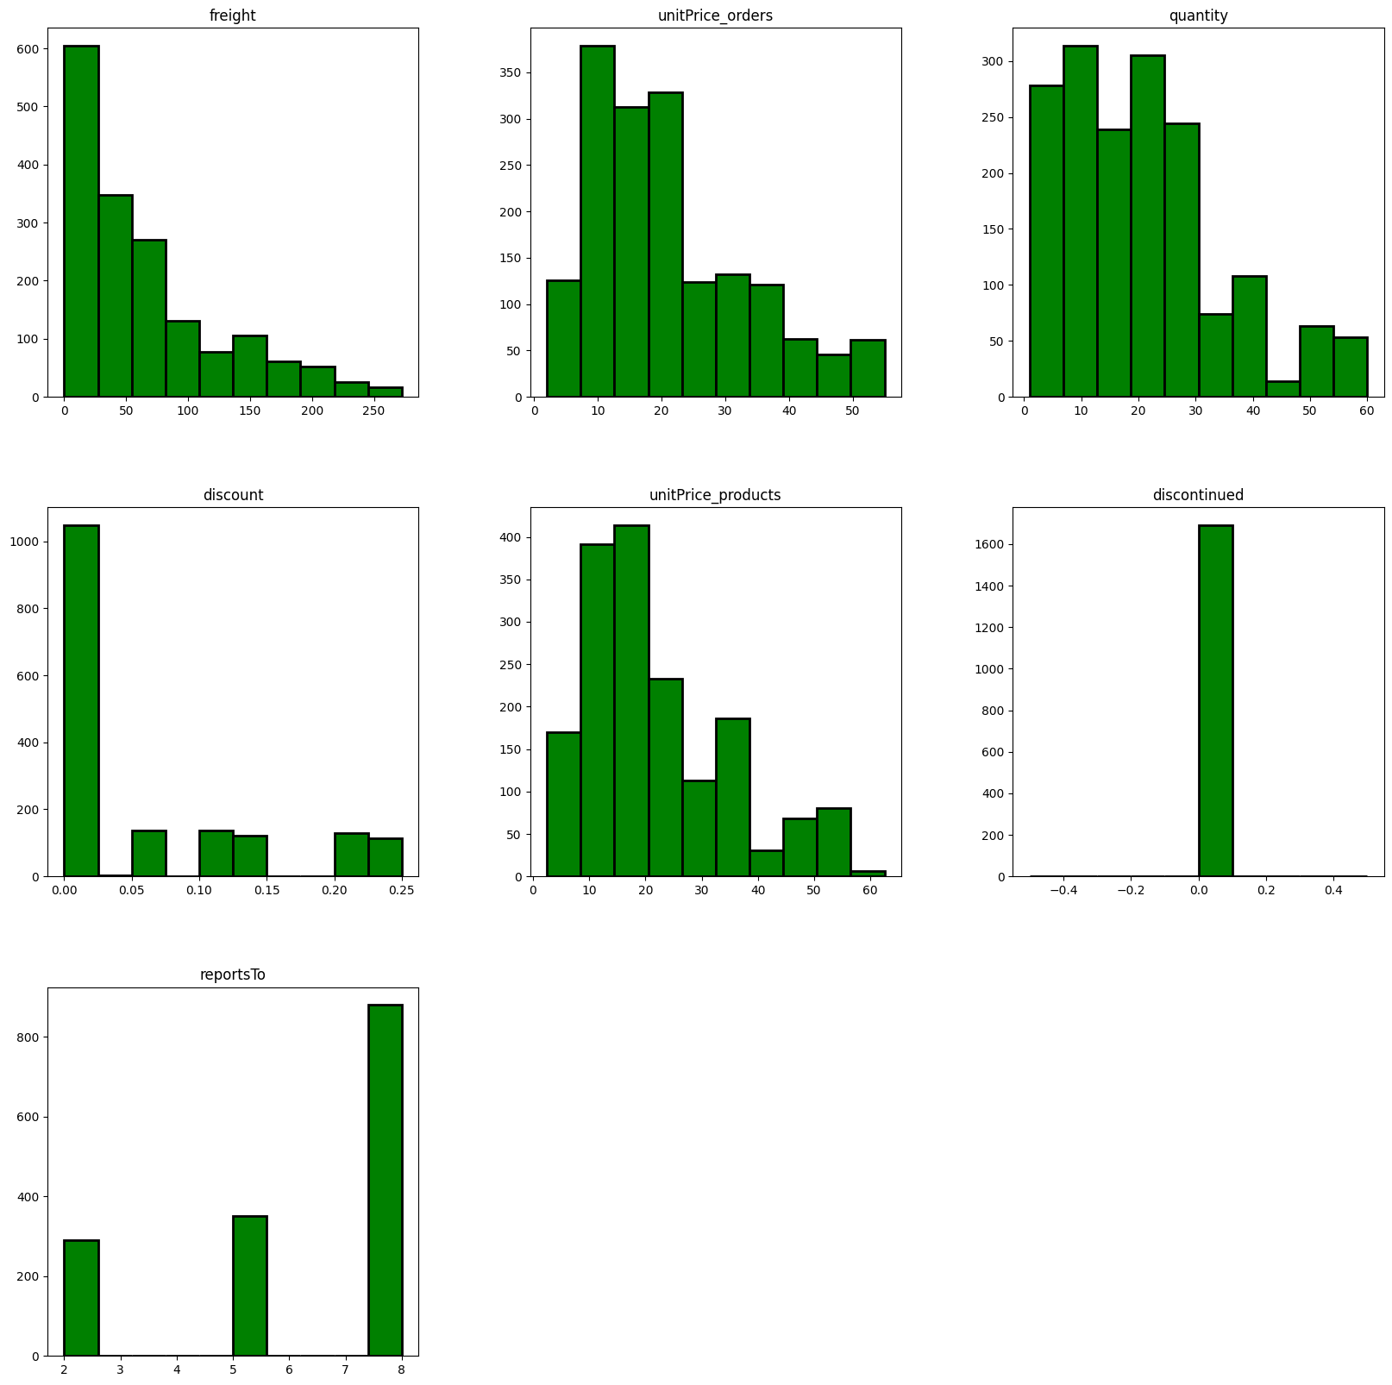
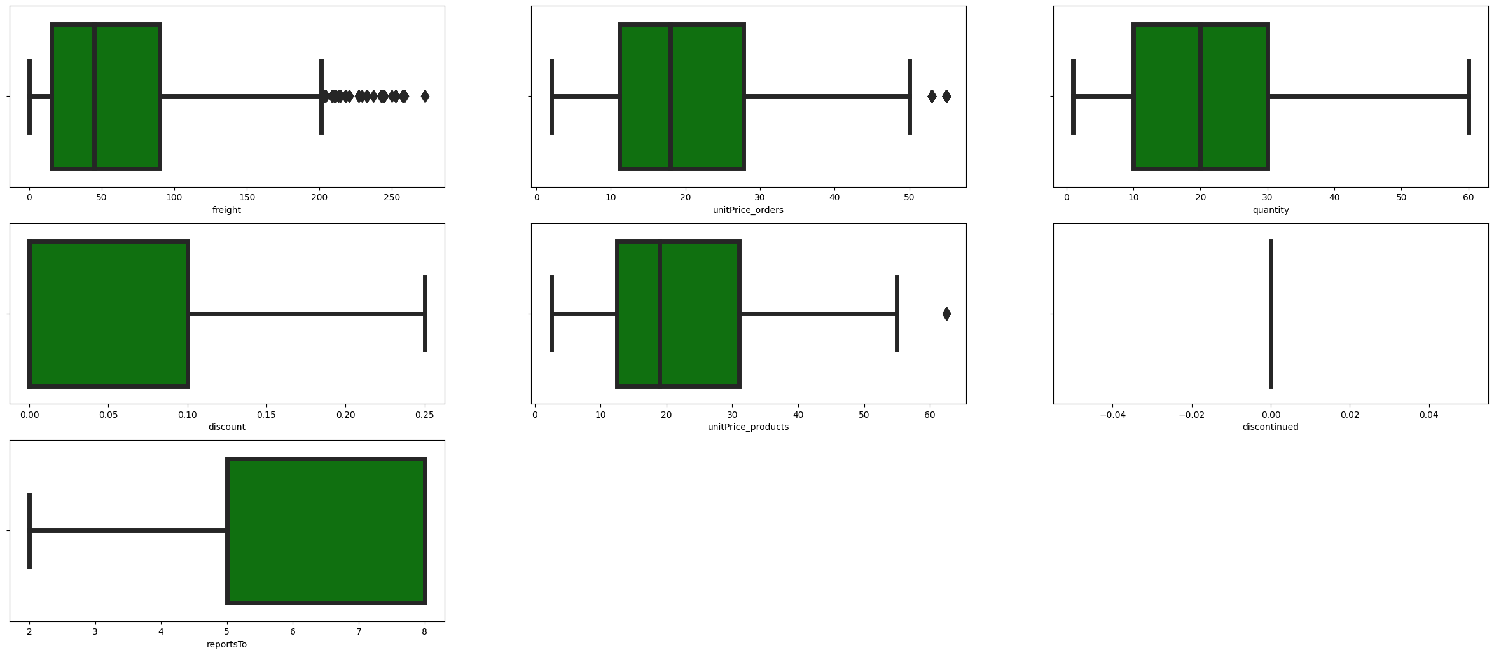
What If I Removed All Outliers
The Number of All outliers 463
21% of the data

Slide 6
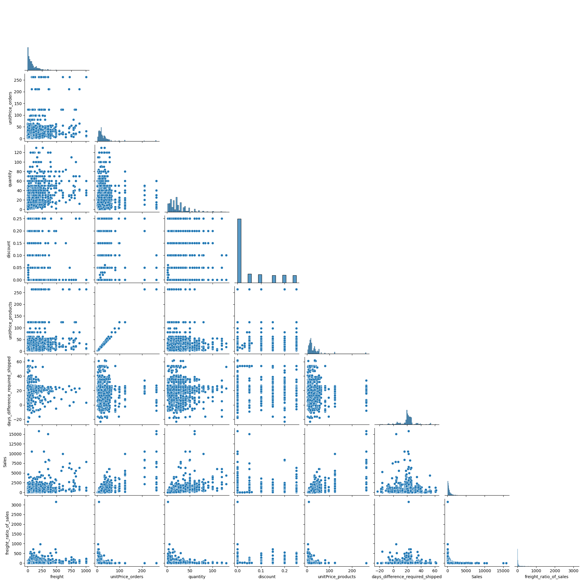
There are positive correlation between sales and quantity,unitPrece_orders
It seems there are negative correlation between sales and discount
Most quantity falls between 0 to 80 and intersects with freight and unitPrce_orders falls between 0 to 250
The days_difference_required_shipped doesn't correlate with sales or quantity it's normal

Slide 7
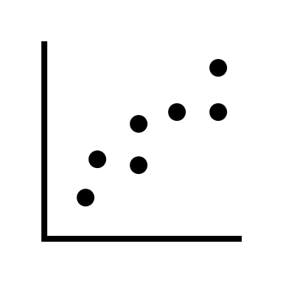
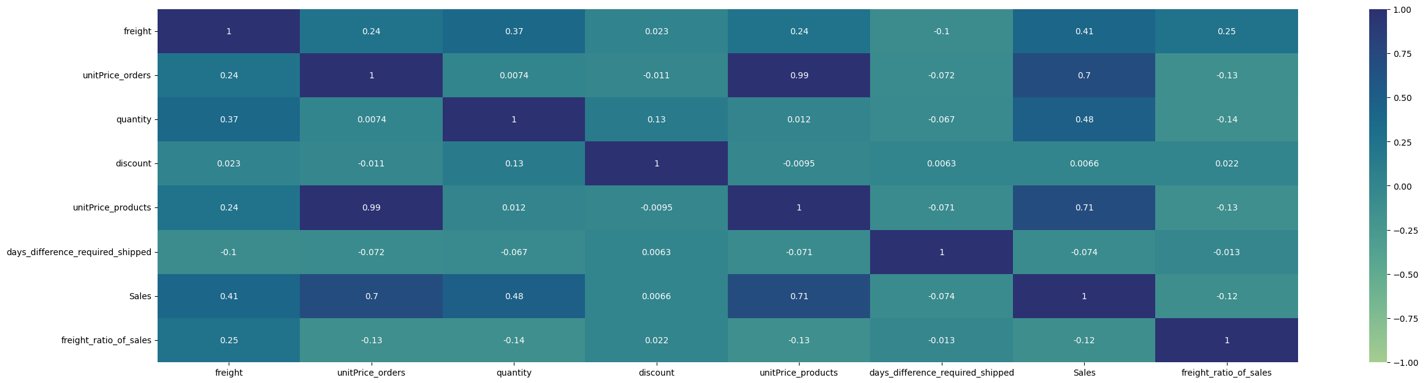
Correlations

Slide 8
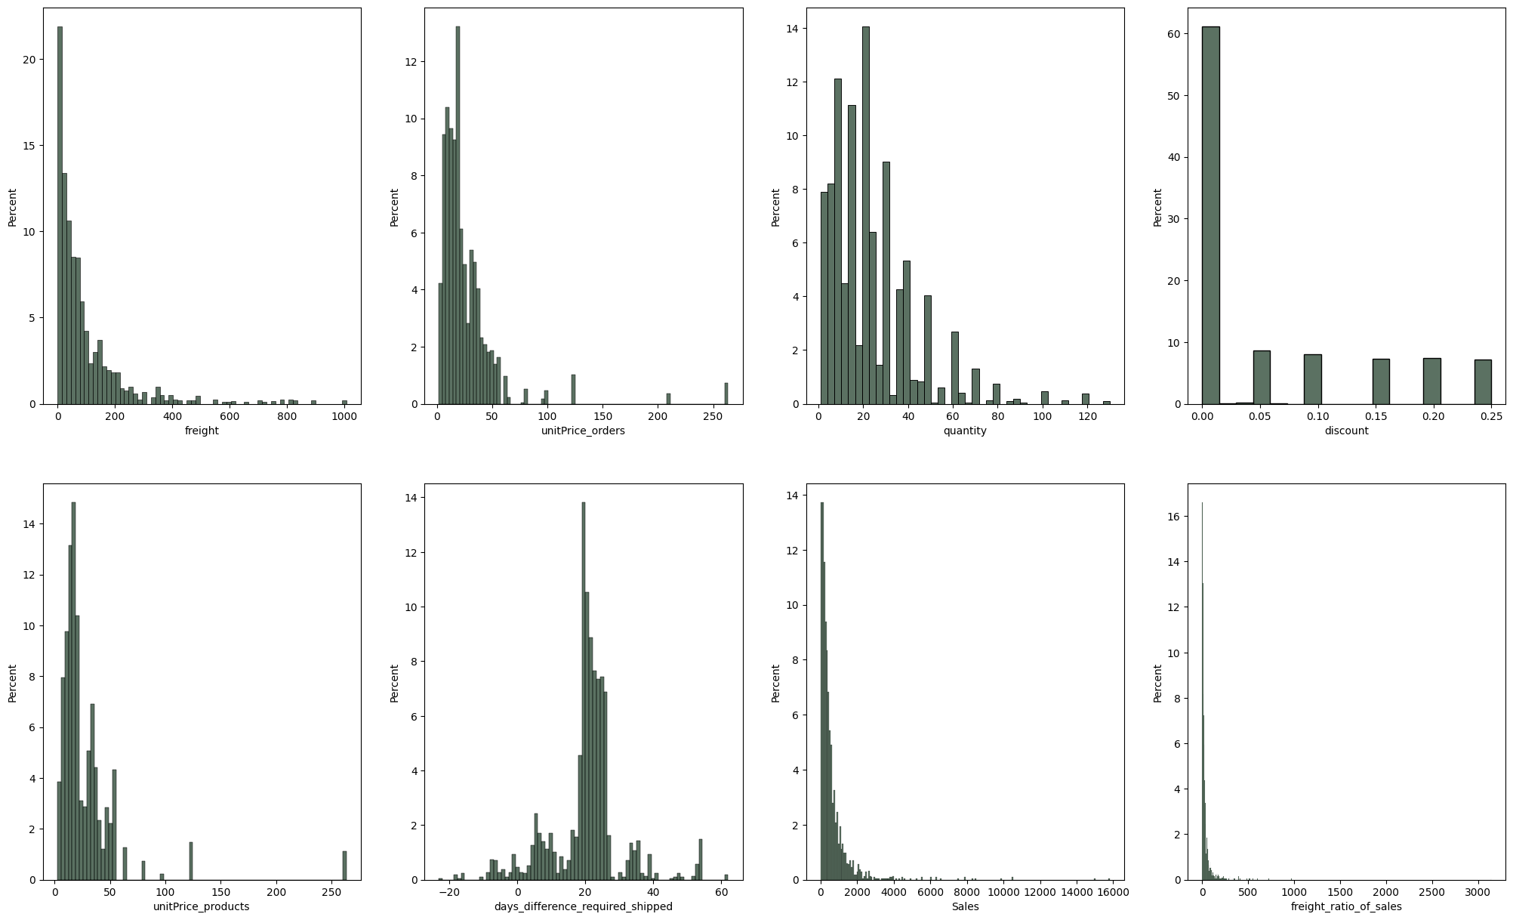
💡Insight
26.0% of freight is between 0 to 20
88.0% of freight is between 0 to 200 and the freight range between 0 to 1000
17.0% of Sales is between 0 to 100 and the Sales range between 0 to 3000
65.0% % of Sales is between 0 to 500 and the Sales range between 0 to 3000
96.0% of quantity is between 0 to 60 and the quantity range between 0 to 120
92.0% of unitPrice_orders is between 0 to 50 and the unitPrice_orders range between 0 to 250
61.0% of discount is between 0 to 0.02 While the discount range between 0 to 0.25

Slide 9

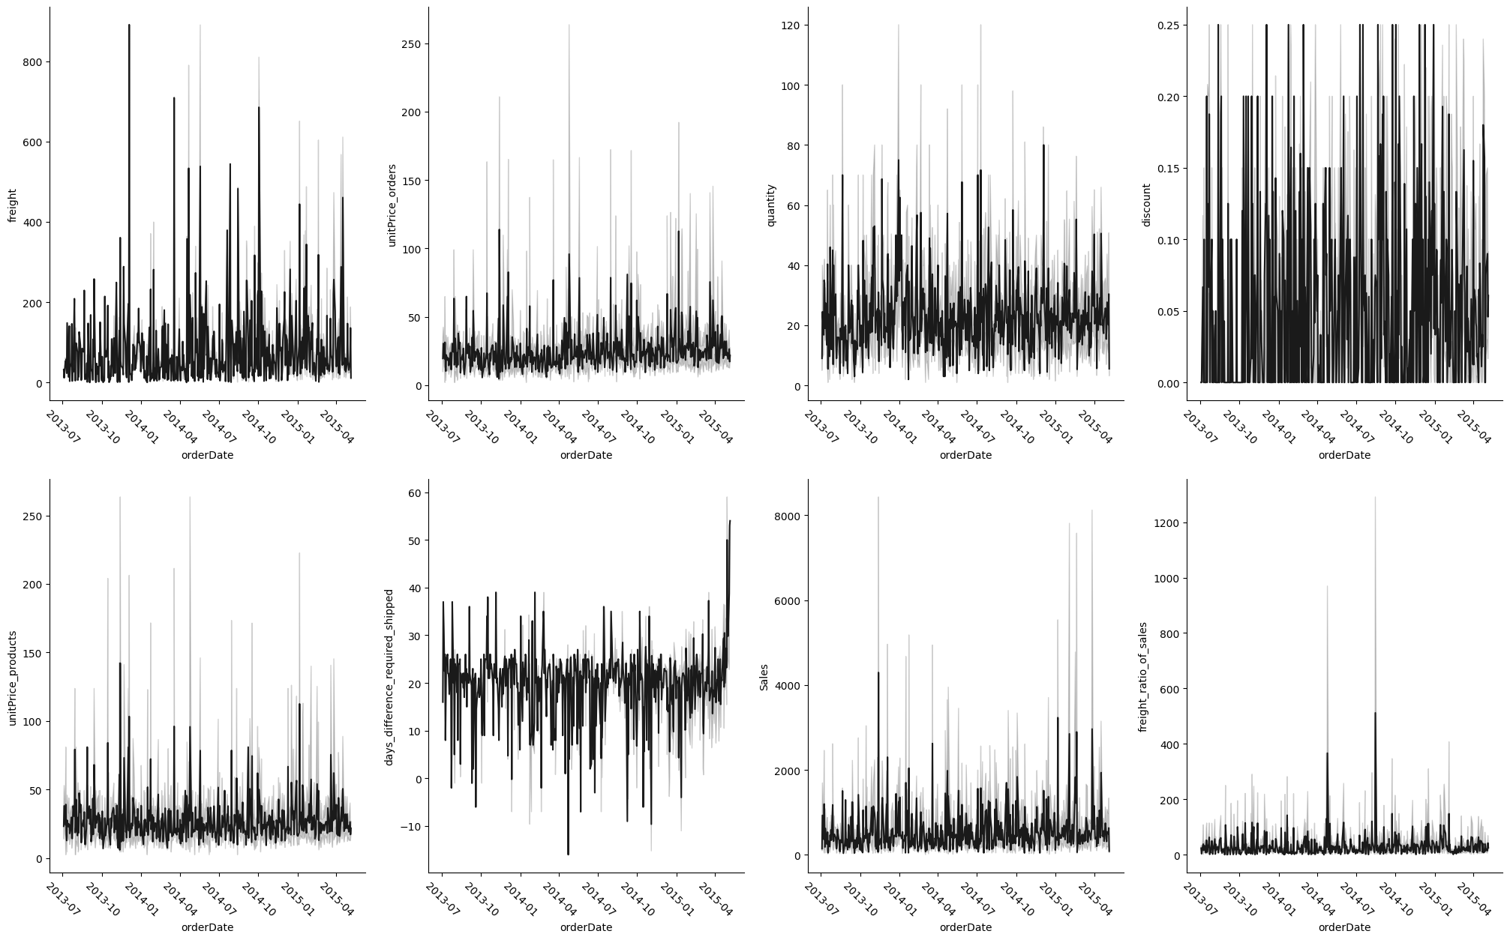
Quick View About Trends

Slide 10
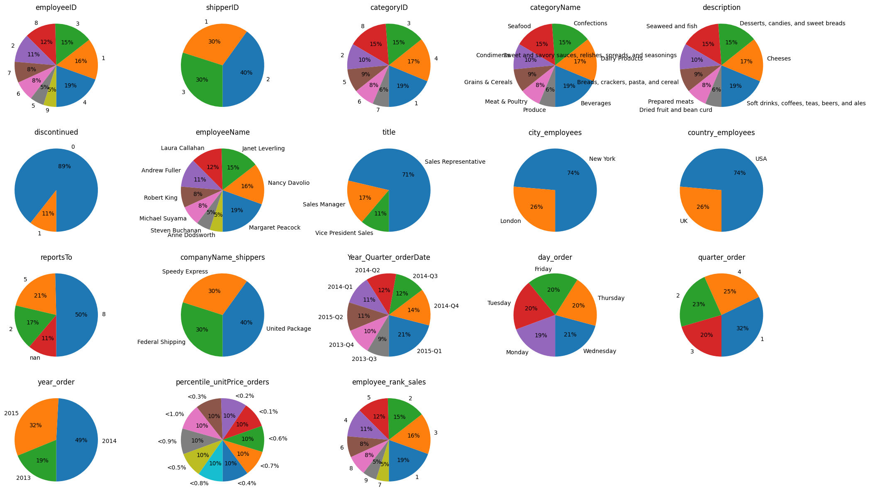
Total Transaction For Each Categorical columns

Slide 11
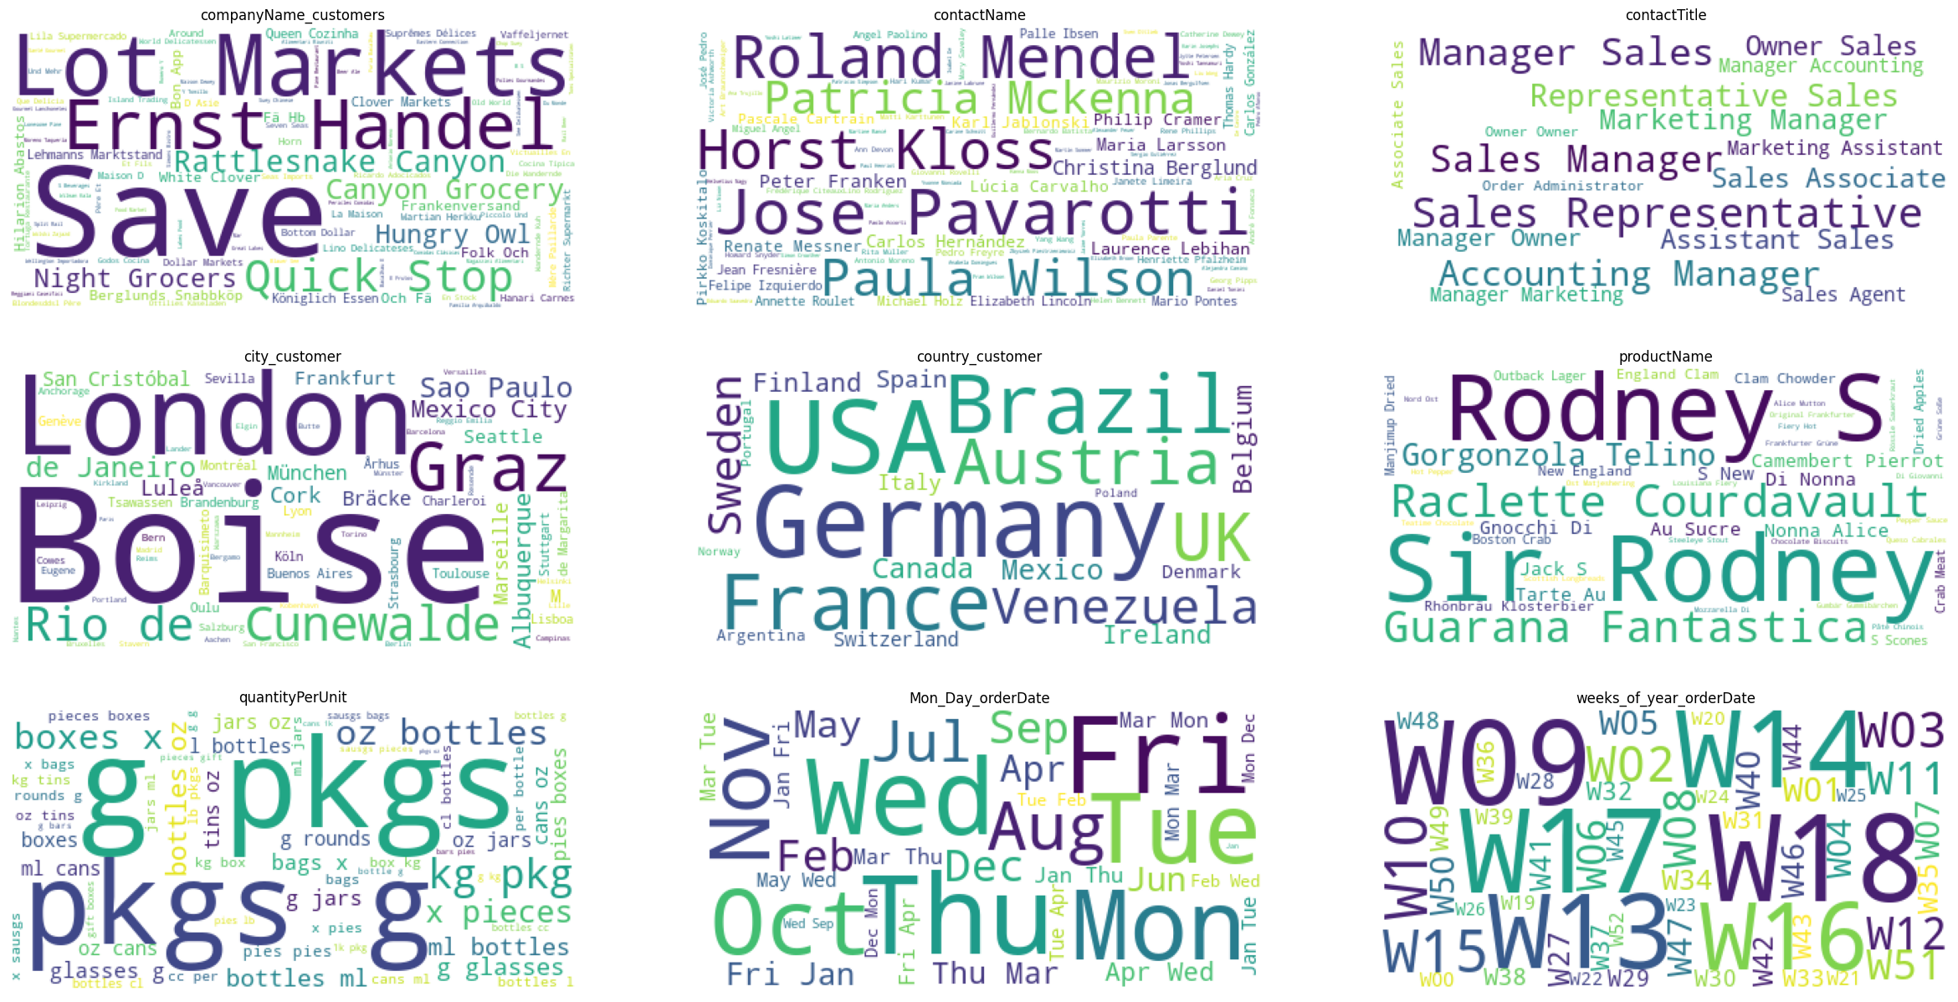
Total Transaction For Each Categorical columns

Slide 12

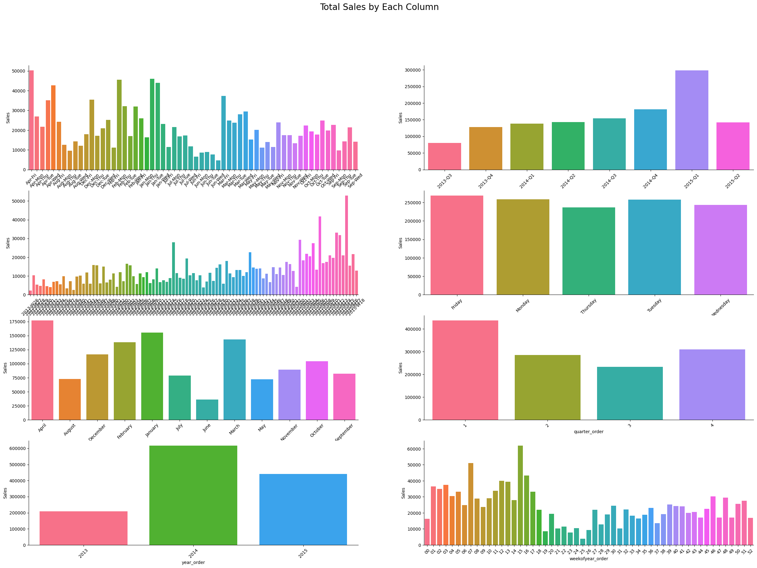
Total Sales By Dates Columns

Slide 13
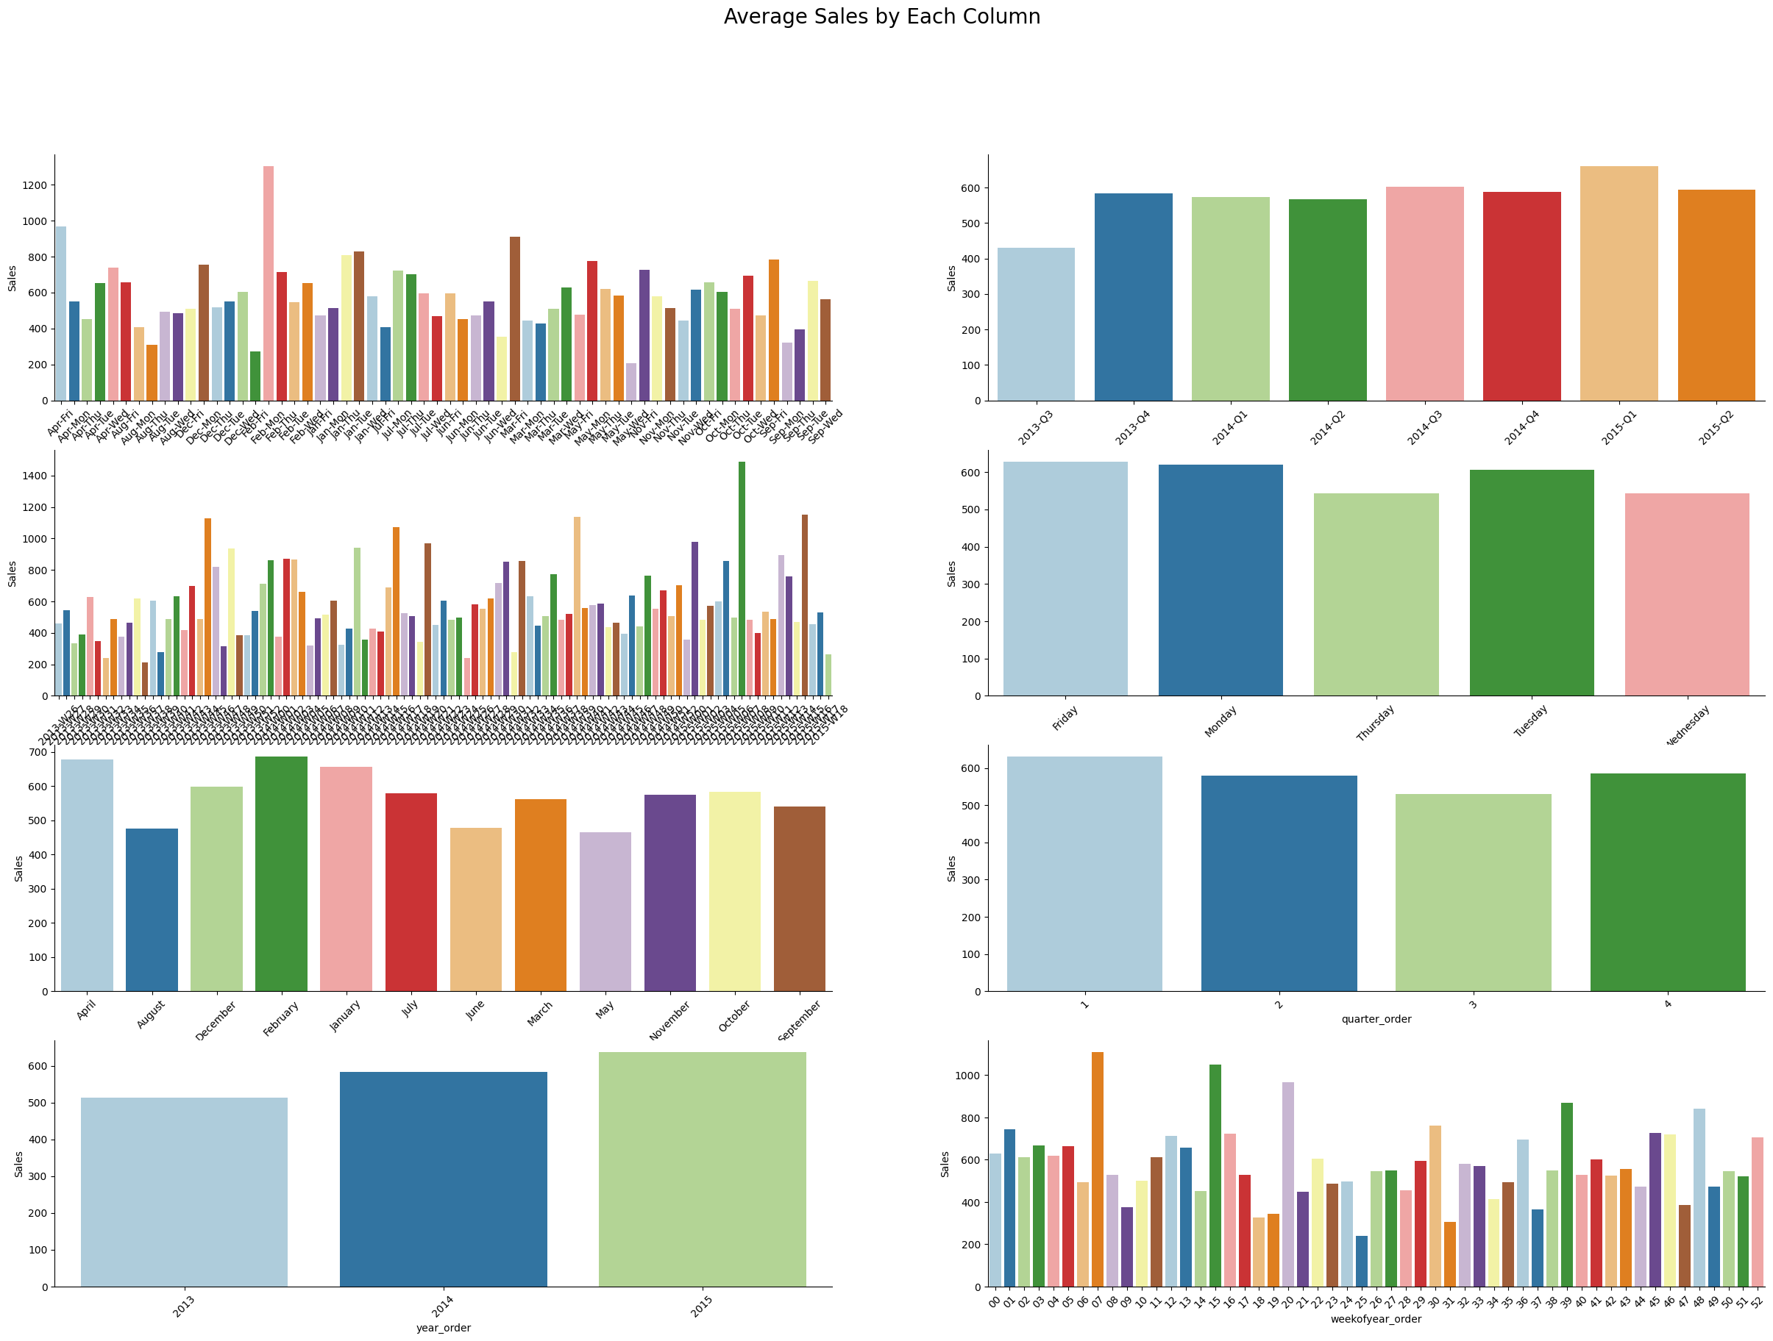
Average Sales By Dates Columns

Slide 14
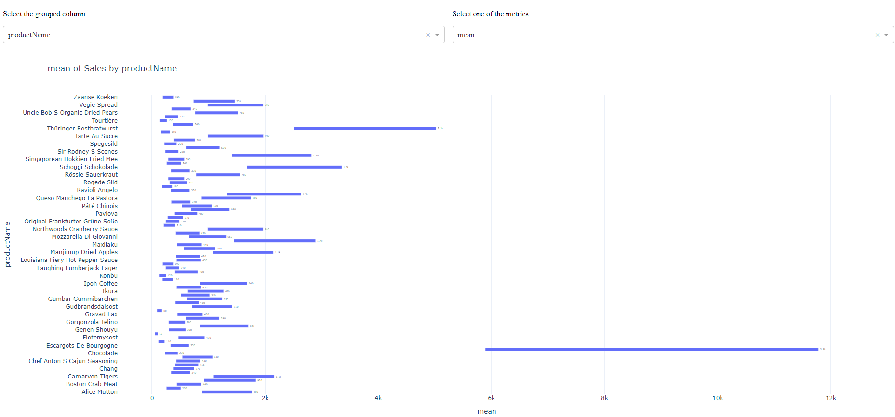
Statistical Analysis
Click to See The Dash
The Describe Of Sales By Categories Columns

Slide 15
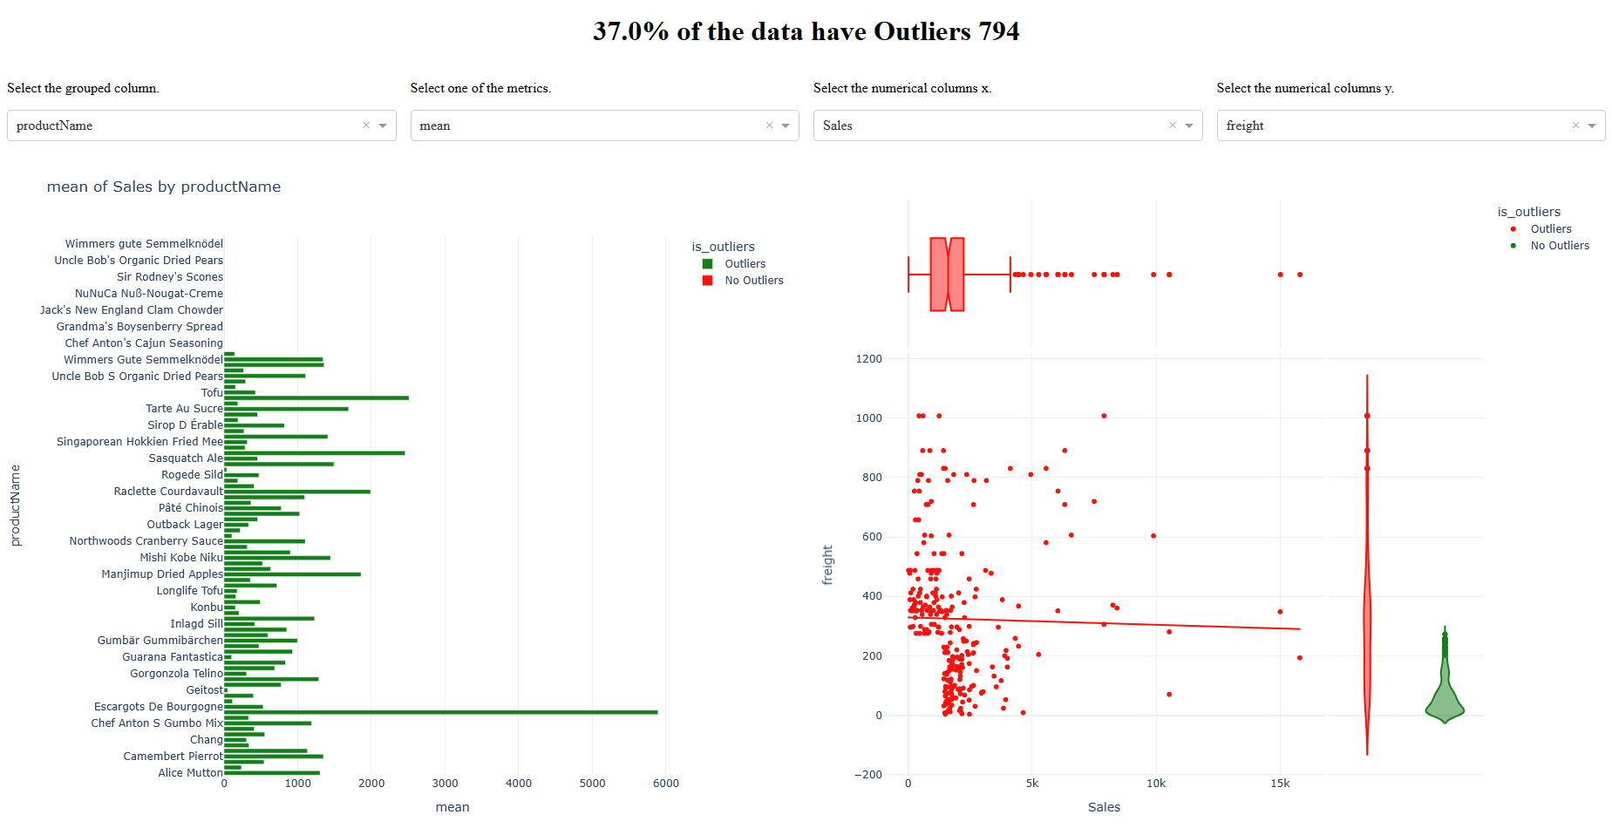
Statistical Analysis
Click To See The Dash

Slide 16

Analysis Questions
Are there any noticeable sales trends over time?
Which are the best and worst selling products?
Can you identify any key customers?
Are shipping costs consistent across providers?
Identify the best and worst employees?

Slide 17

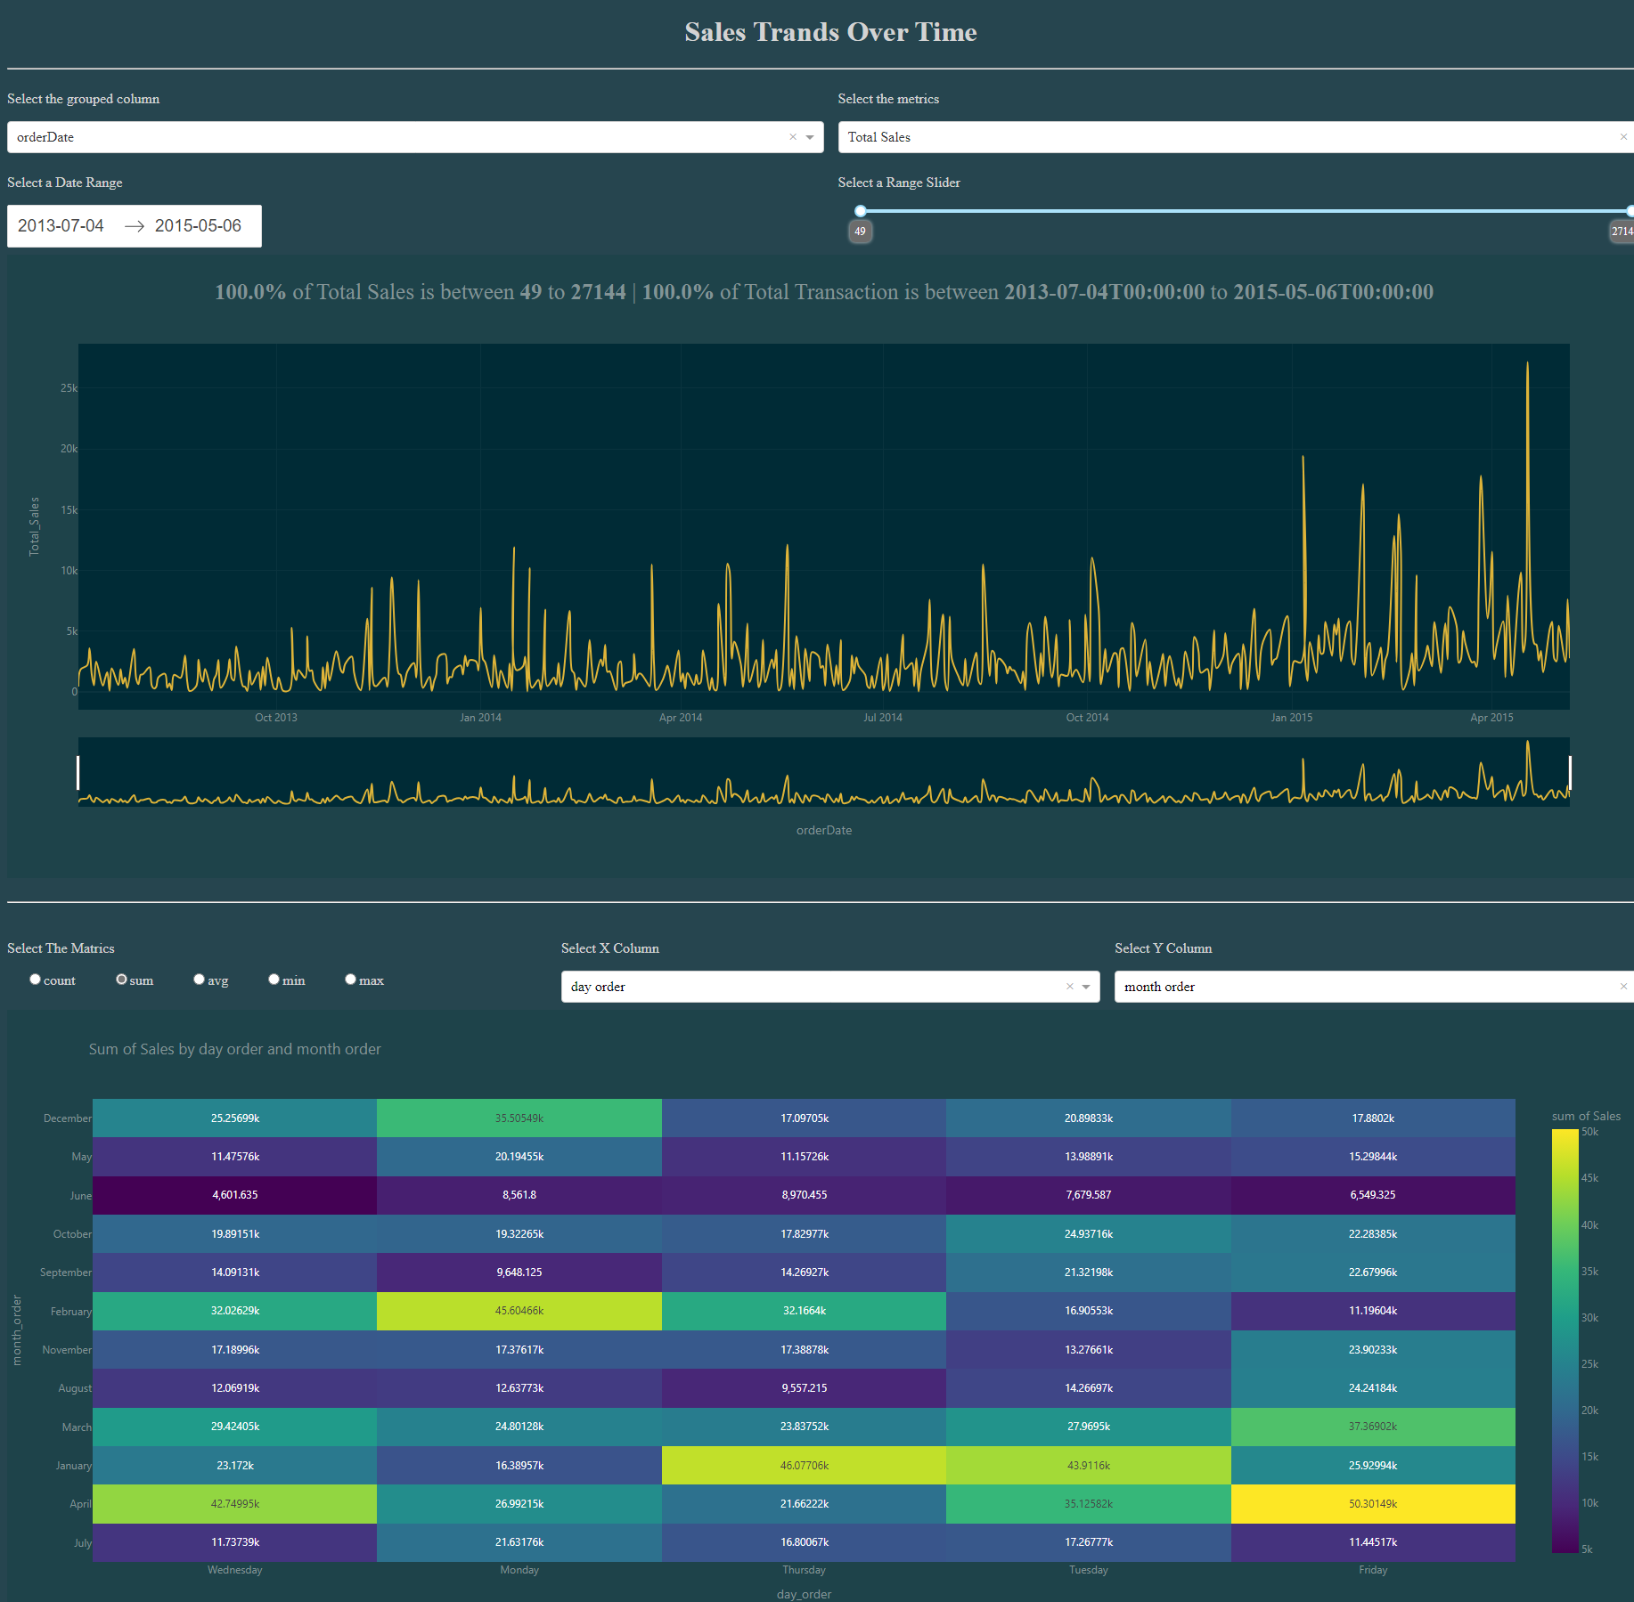

Are there any noticeable sales trends over time?
Click To See The Dash
Insights
Peak Points of Average Sales Per Order:
Dec 4, 2013 = 2,302k
Mar 19, 2014 = 2,623k
Jan 6, 2015 = 3,233k
Mar 27, 2015 = 2,965k
Peak Points of Average Sales Per Customer:
Nov 13, 2013 = 8,593k
Dec 4, 2013 = 9,210k
Mar 19, 2014 = 10k
Jan 6, 2015 = 9,699k
Peak Points of Growth Over 90%:
Jul 19, 2013 | Mar 19, 2014 | Apr 18, 2014 | Apr 22, 2014 |May 19, 2014 | May 23, 2014 |
Jul 7, 2014 | Jul 18, 2014 | Jul 31, 2014 | Sep 4, 2014 | Oct 21, 2014 | Feb 26, 2015
50% of Total Sales is between 49 to 1844 while the original range is between 49 to 27,144
60% of Average Sales is between 40 to 500 while the original range is between 40 to 4,296
57.5% of Total Orders is between 1 to 4 while the original range is between 1 to 32
27% of Total Transaction is between 2013-07-01 To 2013-12-31
54% of Total Transaction is between 2014-01-01 To 2014-12-31
18% of Total Transaction is between 2015-01-01 To 2015-05-31

Slide 18

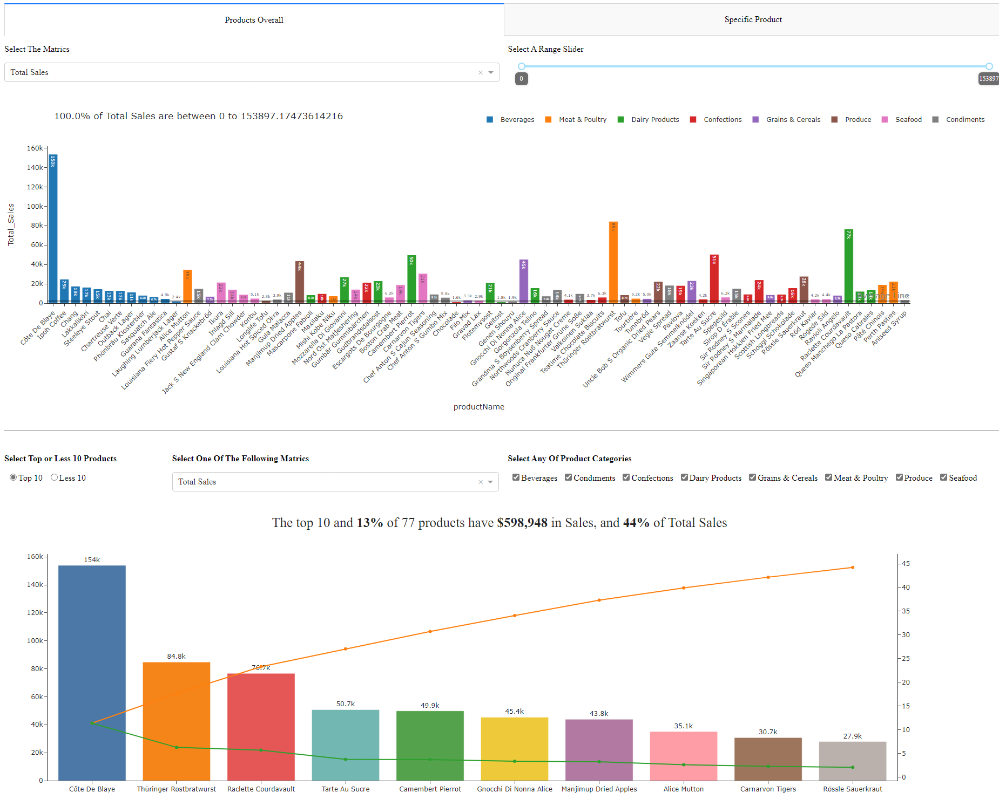
Which are the best and worst selling products?
Click To See The Dash
Insights
90% of Total Sales by products is between 0 to 5000 while the original range is between 0 to 153,897
Cote De Blaye Product have $153,897k in Sales ,and 11% of Total Sales
The Top 10 Product 13% of all 77 Products have $598,948k in Sales ,and 44% of Total Sales
The Less 10 Product 13% of all 77 Products have $27,562k in Sales ,and 2% of Total Sales
Beverage's category has 20% of Total Sales
There are more insights to discover If I try to write it all it'll take tons of hours

Slide 19

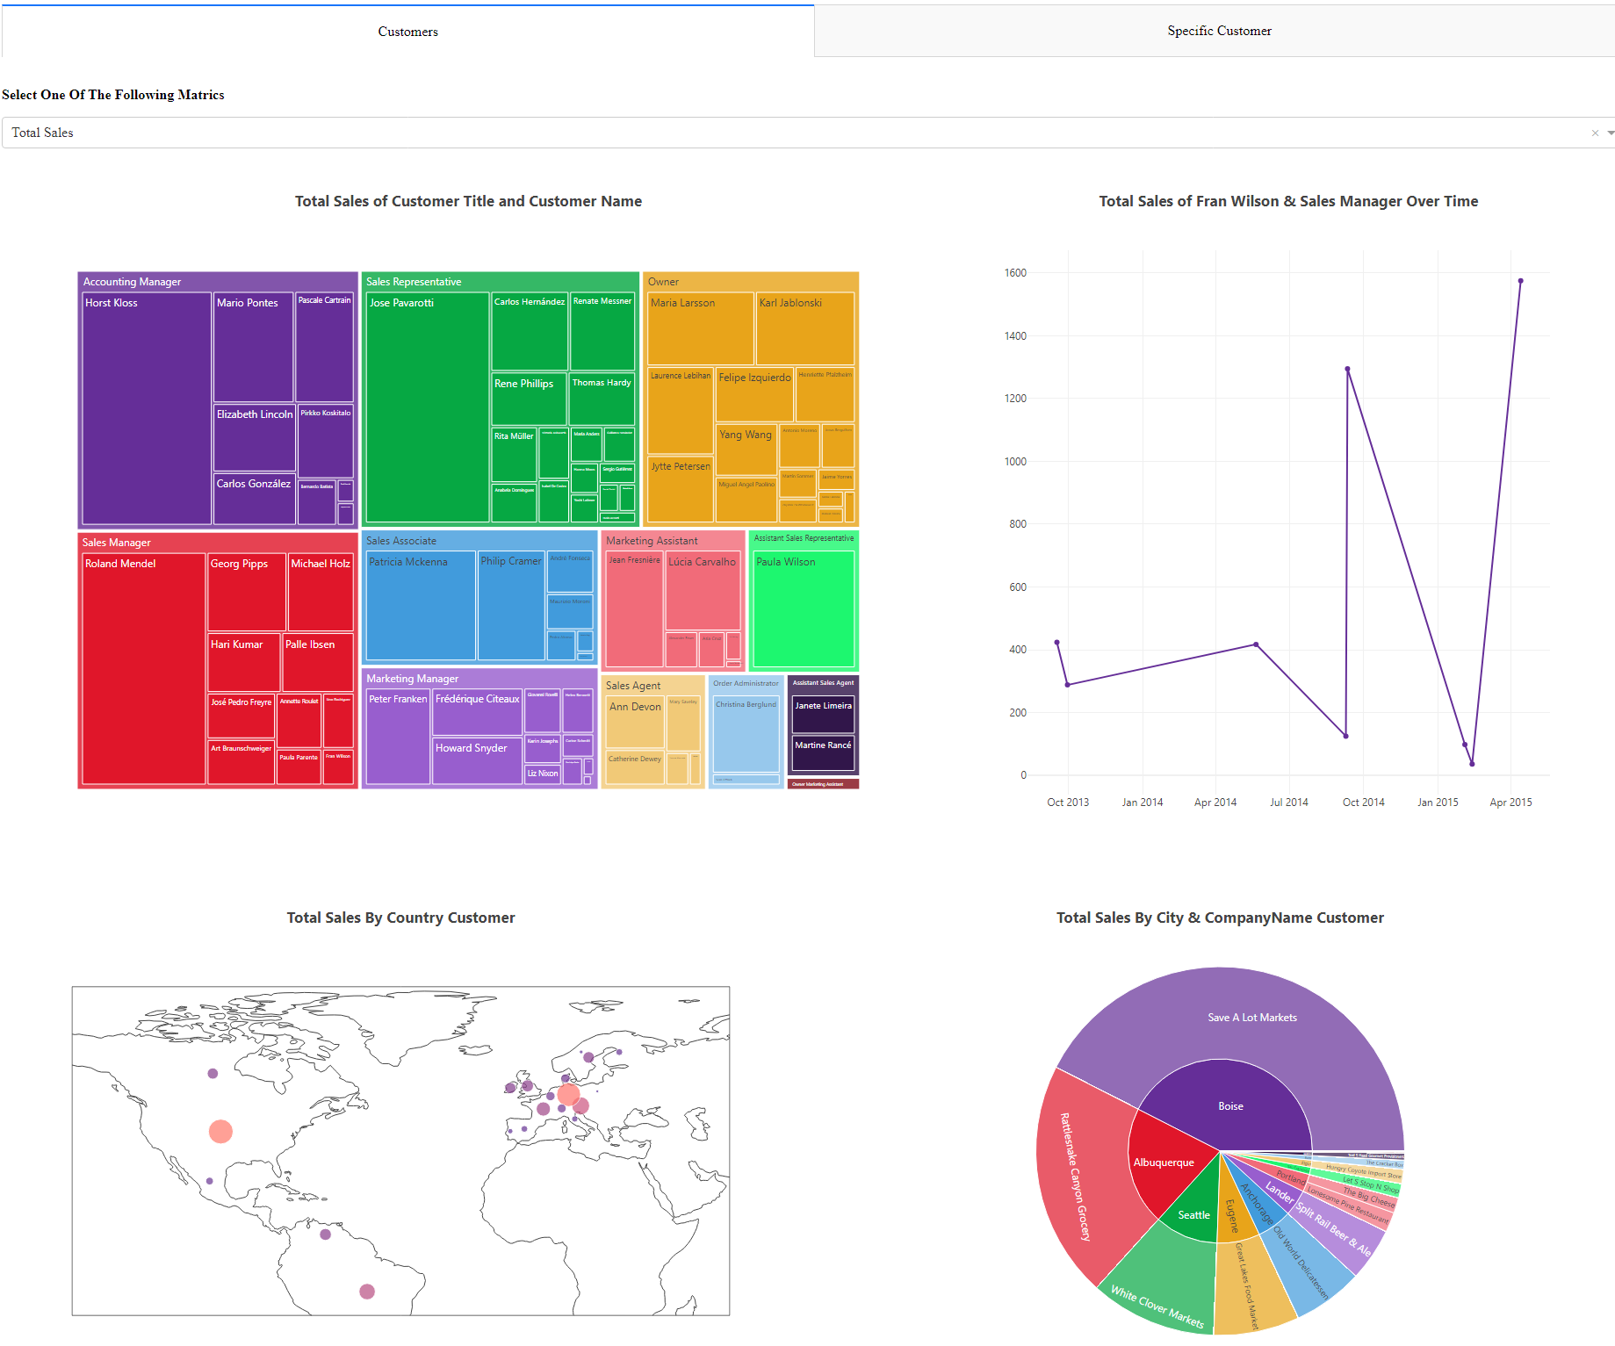
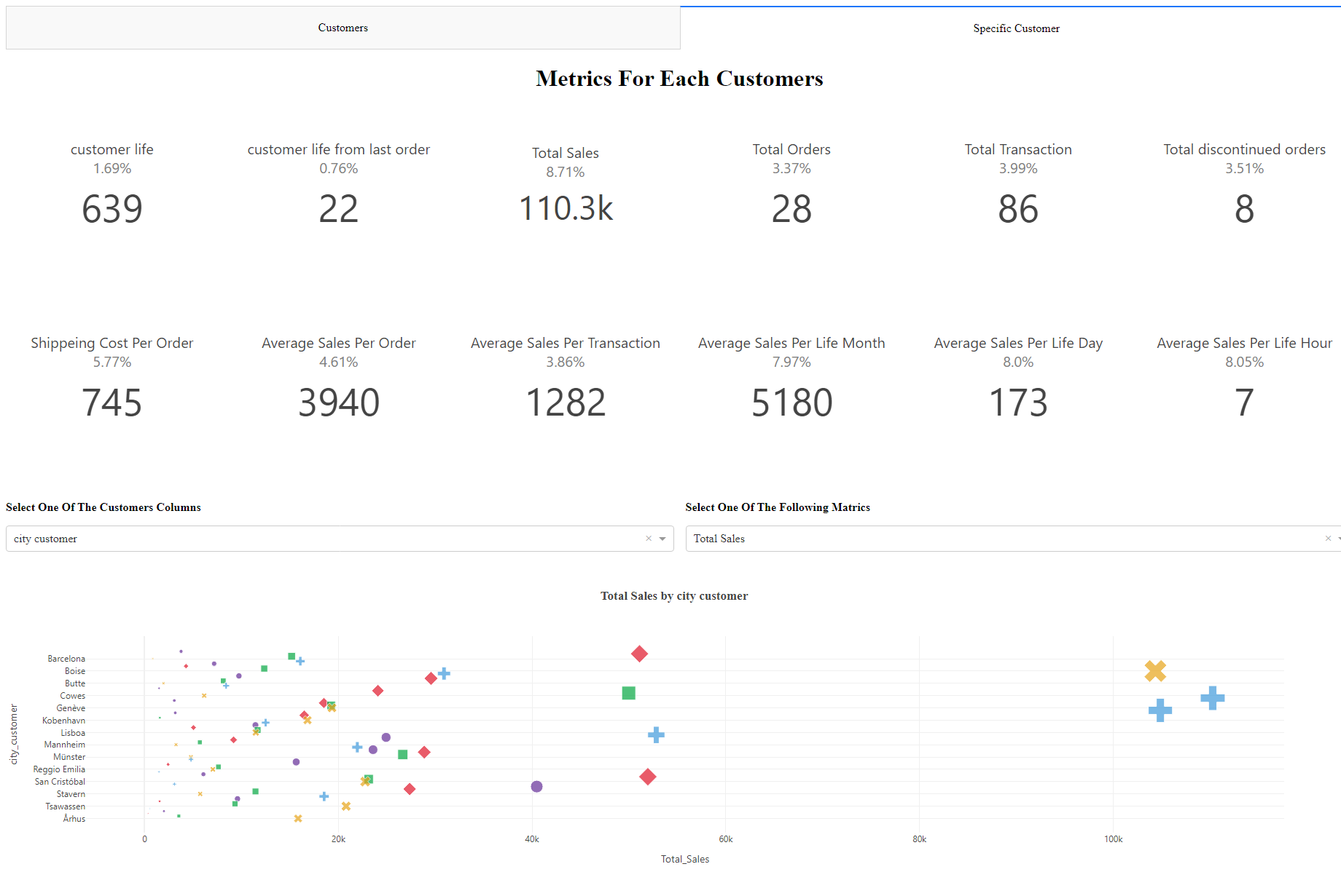
Can you identify any key customers?
Click To See The Dash

Slide 20

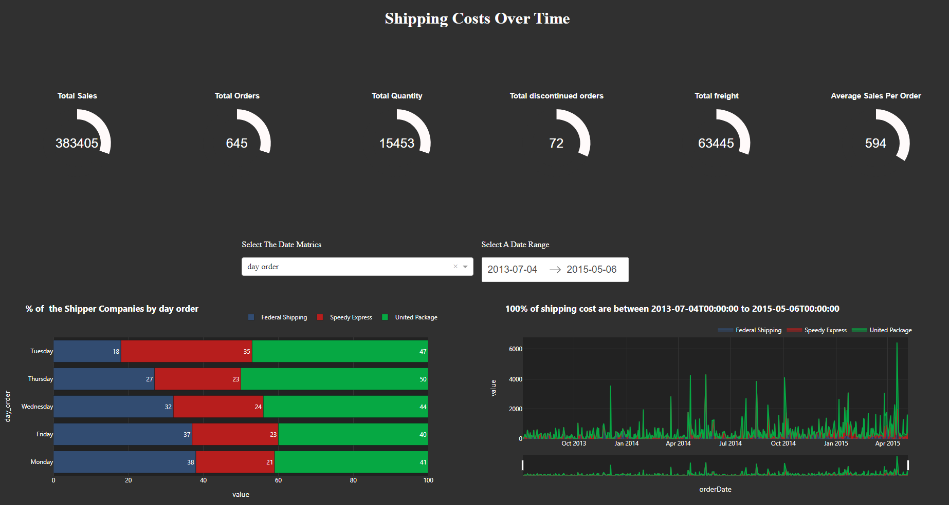
Are shipping costs consistent across providers?
Click To See The Dash

Slide 21

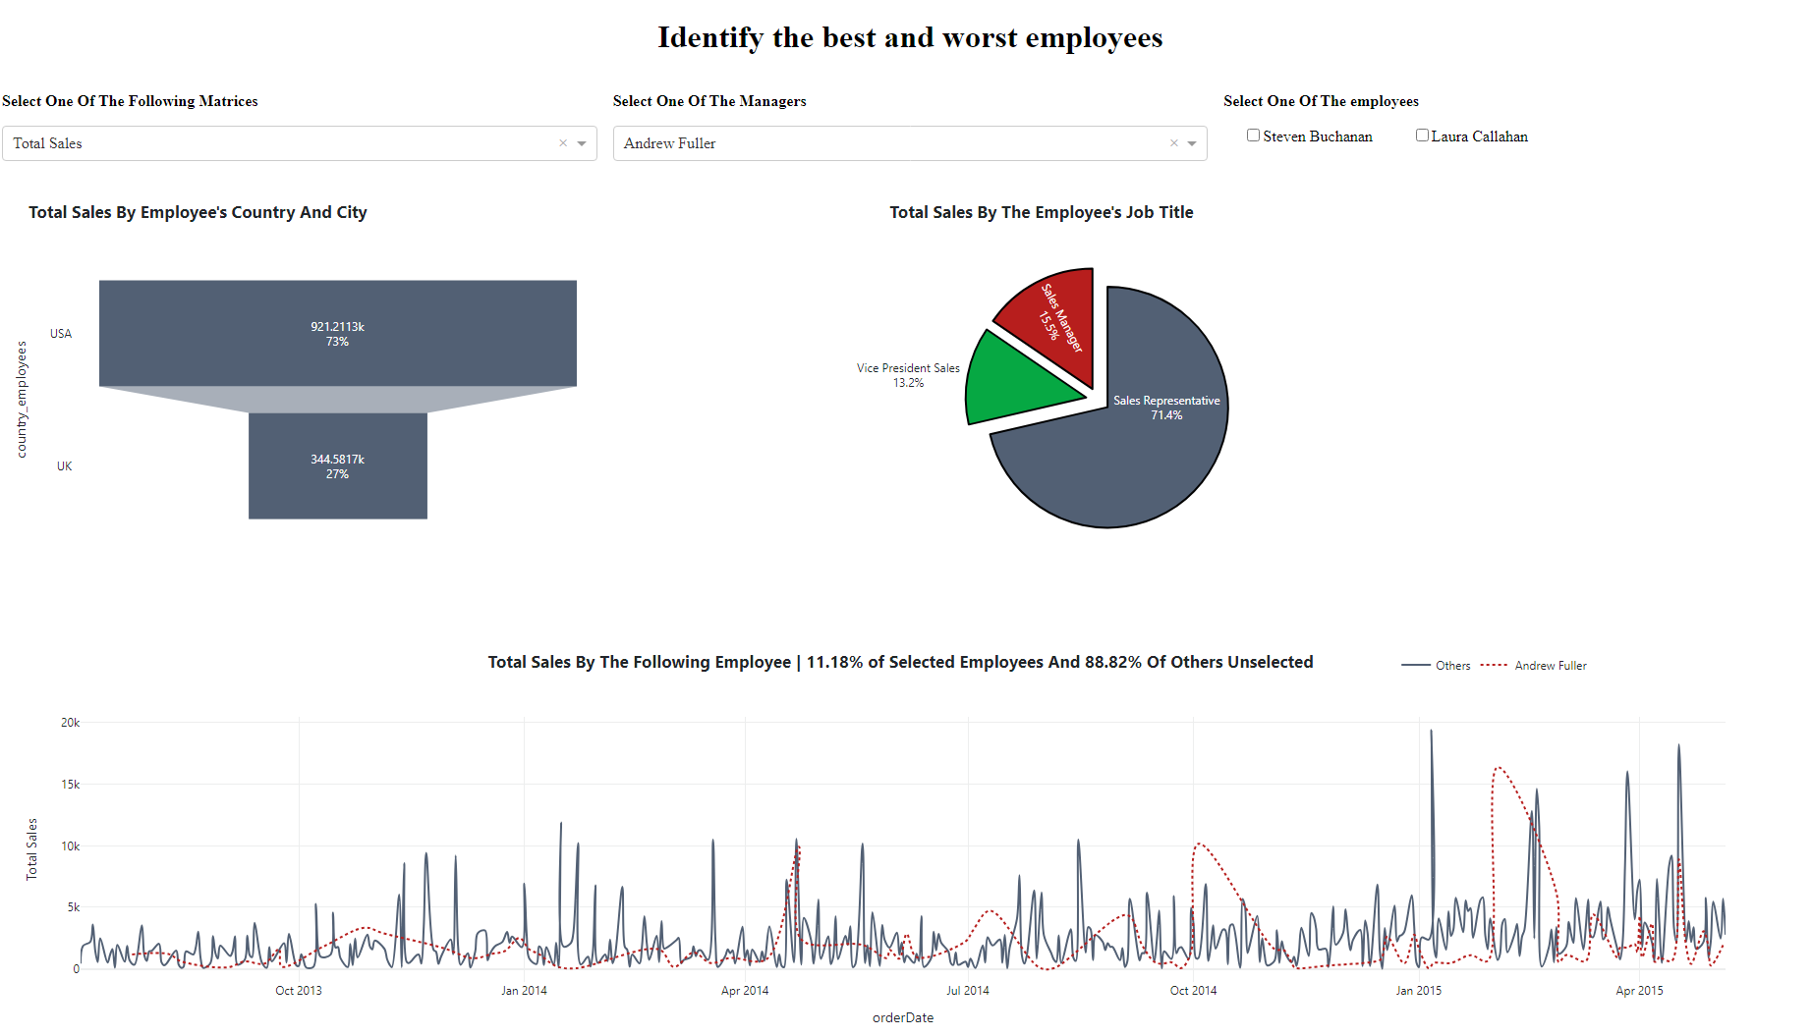
Identify the best and worst employees?
Click To See The Dash

Slide 22

Final Dashboard

Slide 23
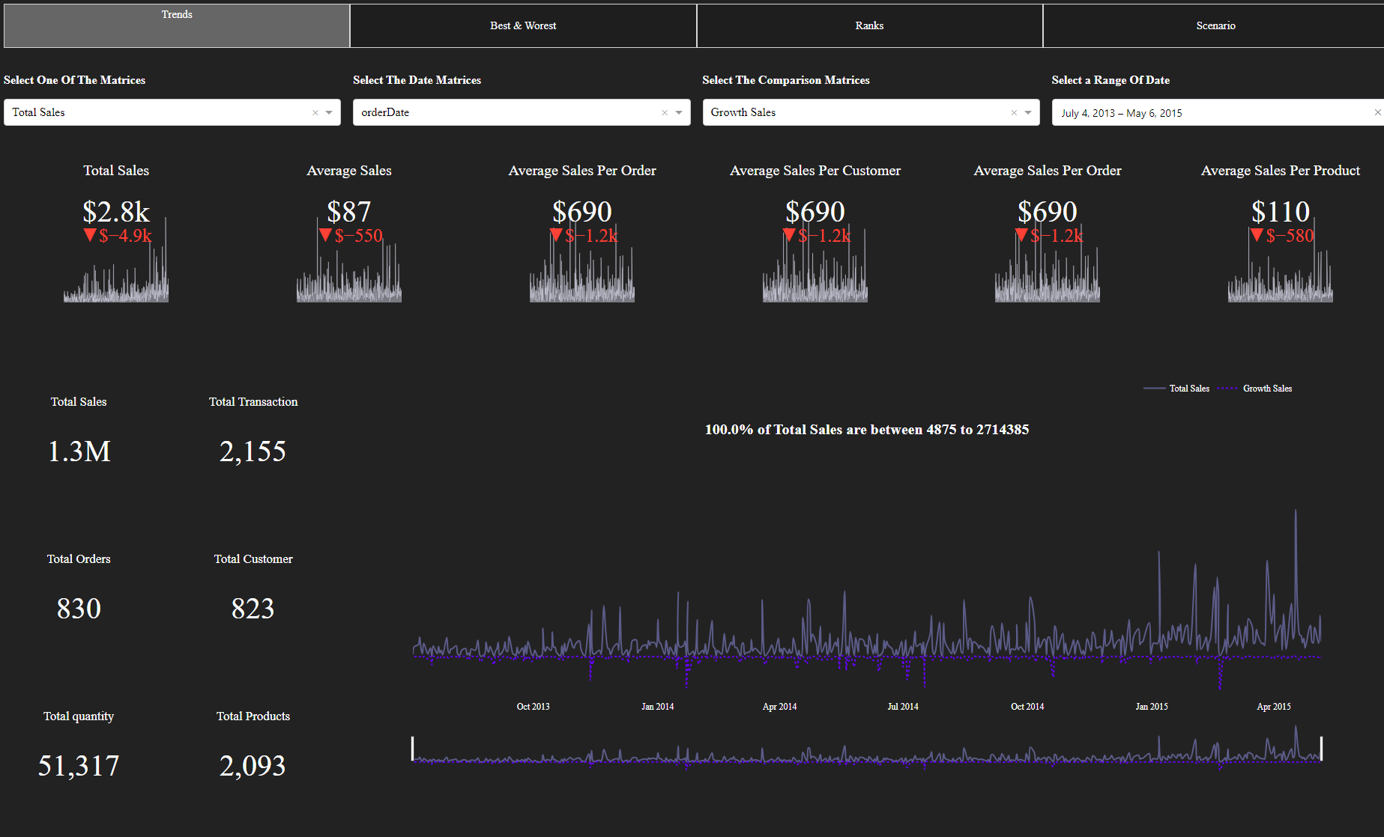
Click To See The Final Dash

Slide 24
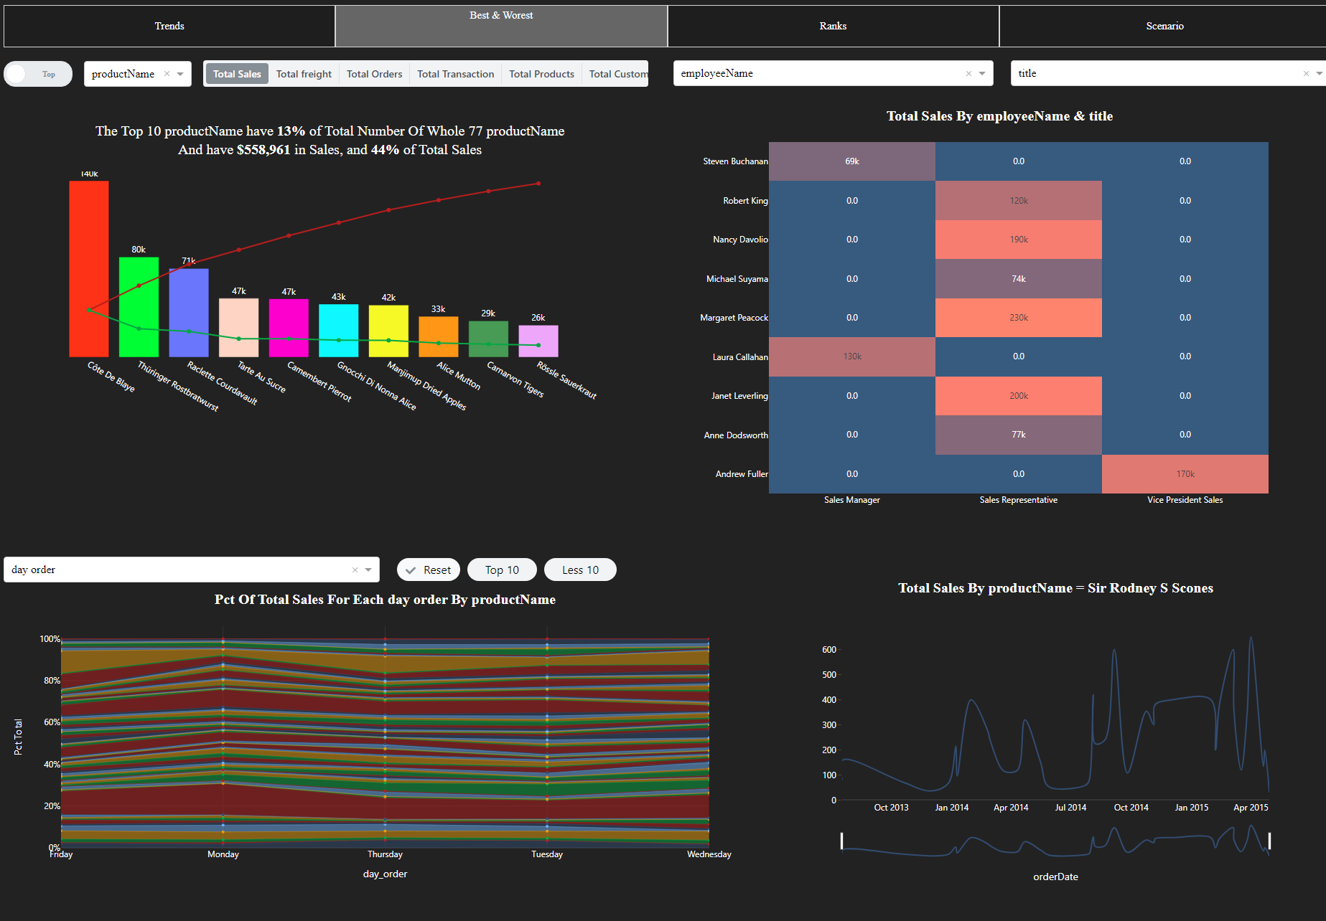
Click To See The Final Dash

Slide 25
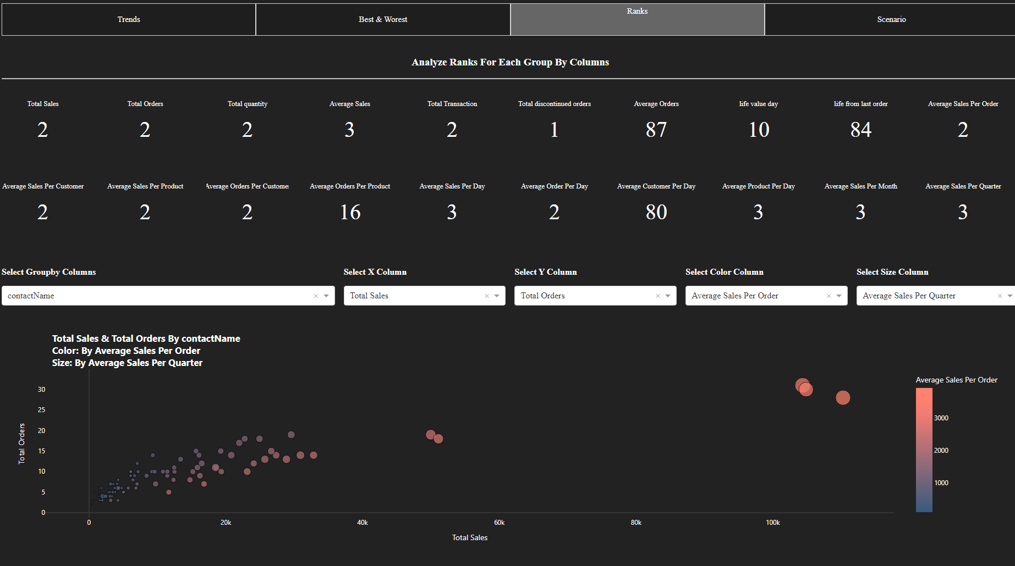
Click To See The Final Dash

Slide 26
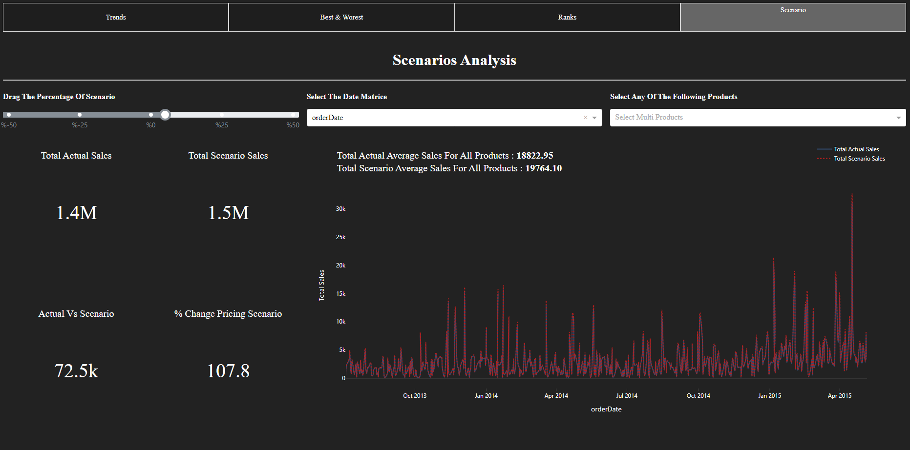
Click To See The Final Dash

Slide 27

Done

